Slide 1
CS2040S Tut 4 Qn 4
Shawn (Xenon)

Slide 2
Problem 4: Economic Research
Main Question Idea: You want to divide the dataset into “equi-wealth” age ranges, and given parameter k, you should output k different lists A₁, A₂, ..., A_{k} with the following properties:
All the ages of people in set A_{j} should be less than or equal to the ages of people in A_{j+1}. That is, each set should be a subset of the original dataset containing a contiguous age range.
The sum of wealth in each set should be (roughly) the same
Note: This means that each set of people may be of different size!

Slide 3
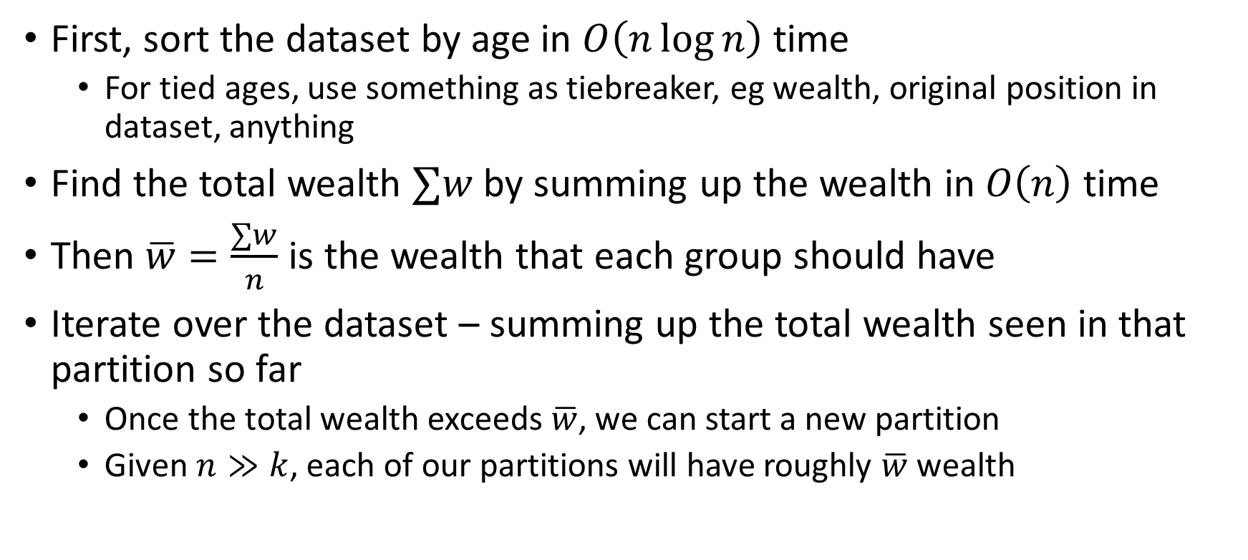
Initial Solution
First, sort the dataset by age in $O\left(n\log{n}\right)$ time
For tied ages, use something as tiebreaker, eg wealth, original position in dataset, anything
Find the total wealth $∑w$ by summing up the wealth in $O\left(n\right)$ time
Then $\overline{w}=\frac{∑w}{n}$ is the wealth that each group should have
Iterate over the dataset – summing up the total wealth seen in that partition so far
Once the total wealth exceeds $\overline{w}$, we can start a new partition
Given $n≫k$, each of our partitions will have roughly $\overline{w}$ wealth

Slide 4

Initial Solution
Overall time complexity is $O\left(n\log{n}\right)$
Can we do better?

Slide 5
Thoughts
Feeling lost?
Try to model this question to similar problems/algorithms you have seen before!

Slide 6

Better Solution
This question is similar to finding the $\frac{1}{k},\frac{2}{k},…,\frac{k−1}{k}$ order statistics!

Slide 7

Better Solution
Find $\overline{w}=\frac{∑w}{n}$ as in the previous solution.
Now, imagine if we only need to find the first group with total wealth about $\overline{w}$.
We can do QuickSelect!

Slide 8
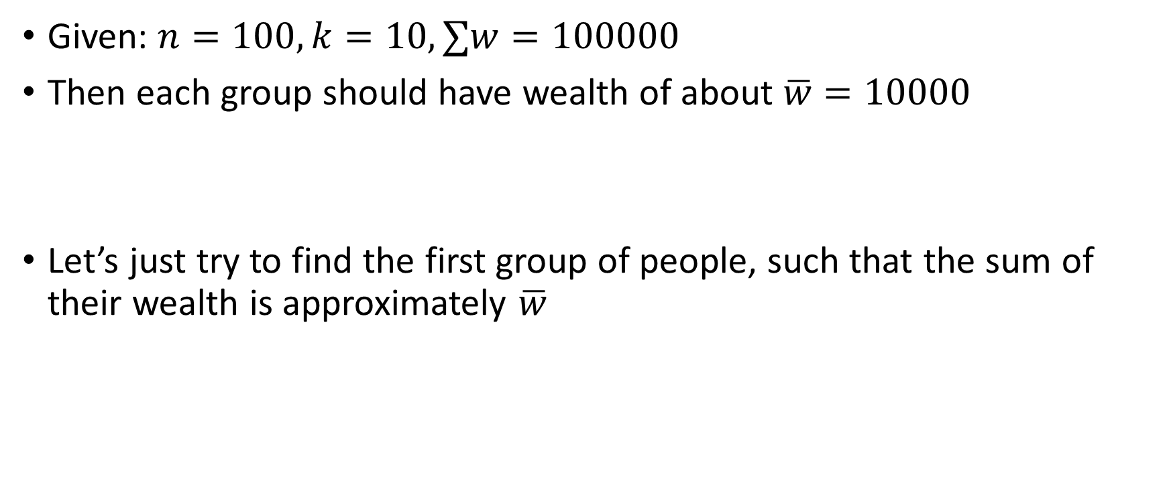
Better Solution
Given: $n=100, k=10, ∑w=100000$
Then each group should have wealth of about $\overline{w}=10000$
Let’s just try to find the first group of people, such that the sum of their wealth is approximately $\overline{w}$
Age: 17 W: 200 | Age: 50 W: 2856 | Age: 73 W: 1906 | Age: 59 W: 2159 | Age: 17 W: 6500 | Age: 22 W: 3492 | Age: 46 W: 1949 | Age: 49 W: 3782 | Age: 76 W: 3155 | … | Age: 67 W: 709

Slide 9
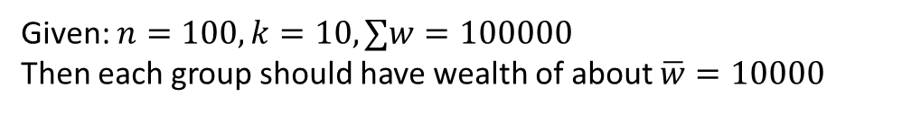
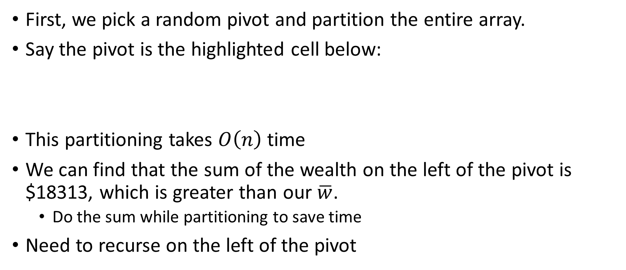
Better Solution
Given: $n=100, k=10, ∑w=100000$
Then each group should have wealth of about $\overline{w}=10000$
First, we pick a random pivot and partition the entire array.
Say the pivot is the highlighted cell below:
This partitioning takes $O\left(n\right)$ time
We can find that the sum of the wealth on the left of the pivot is $18313, which is greater than our $\overline{w}$.
Do the sum while partitioning to save time
Need to recurse on the left of the pivot
Age: 17 W: 6500 | Age: 17 W: 950 | Age: 18 W: 3492 | Age: 16 W: 200 | Age: 18 W: 1226 | Age: 17 W: 5700 | Age: 19 W: 245 | Age: 19 W: 5724 | Age: 76 W: 3155 | … | Age: 67 W: 709

Slide 10
Better Solution
Given: $n=100, k=10, ∑w=100000$
Then each group should have wealth of about $\overline{w}=10000$
Let’s pick another pivot randomly, highlighted blue below:
We can find that the sum of the wealth on the left of the blue pivot is $1150. Including the blue pivot, it’s $6850.
Still not enough to form a group!
We need to recurse on the right of the pivot
Age: 16 W: 200 | Age: 17 W: 950 | Age: 17 W: 5700 | Age: 18 W: 1226 | Age: 17 W: 6500 | Age: 18 W: 3492 | Age: 19 W: 245 | Age: 19 W: 5724 | Age: 76 W: 3155 | … | Age: 67 W: 709

Slide 11
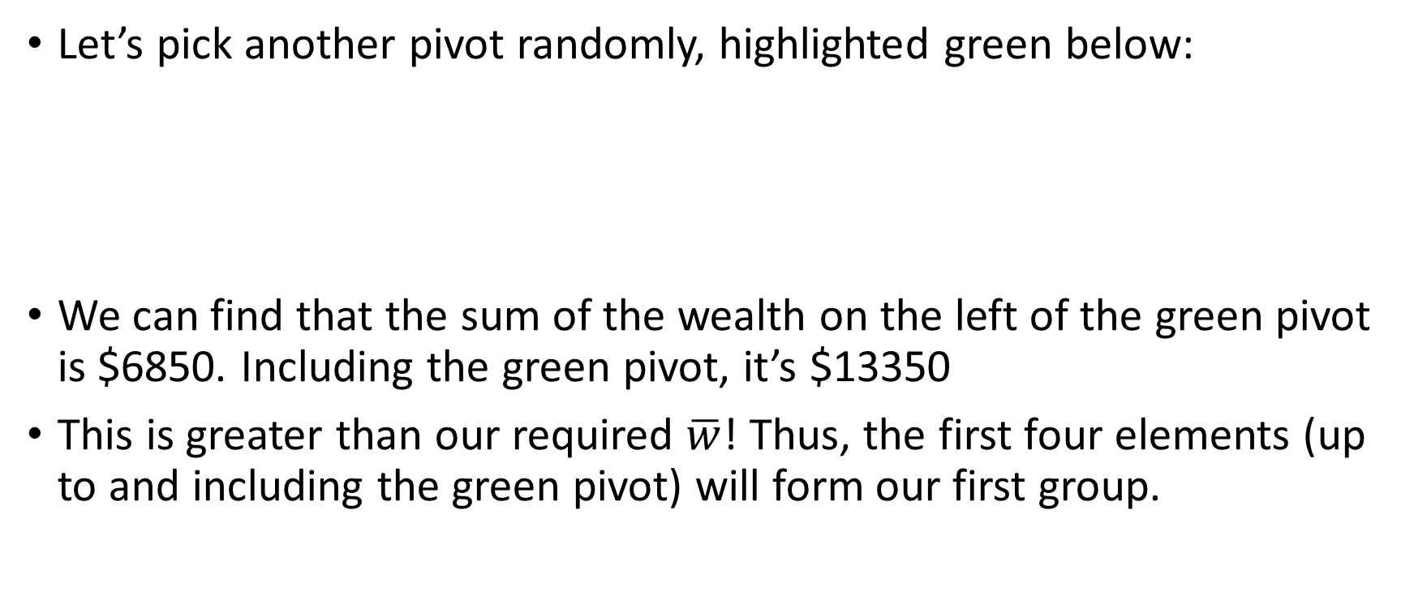
Better Solution
Given: $n=100, k=10, ∑w=100000$
Then each group should have wealth of about $\overline{w}=10000$
Let’s pick another pivot randomly, highlighted green below:
We can find that the sum of the wealth on the left of the green pivot is $6850. Including the green pivot, it’s $13350
This is greater than our required $\overline{w}$! Thus, the first four elements (up to and including the green pivot) will form our first group.
Age: 16 W: 200 | Age: 17 W: 950 | Age: 17 W: 5700 | Age: 17 W: 6500 | Age: 18 W: 1226 | Age: 18 W: 3492 | Age: 19 W: 245 | Age: 19 W: 5724 | Age: 76 W: 3155 | … | Age: 67 W: 709

Slide 12
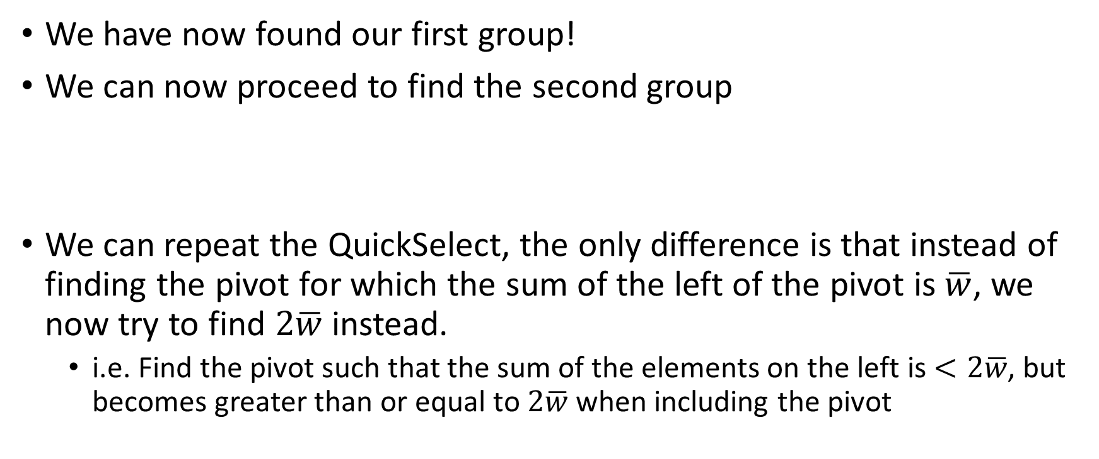
Better Solution
Given: $n=100, k=10, ∑w=100000$
Then each group should have wealth of about $\overline{w}=10000$
We have now found our first group!
We can now proceed to find the second group
We can repeat the QuickSelect, the only difference is that instead of finding the pivot for which the sum of the left of the pivot is $\overline{w}$, we now try to find $2\overline{w}$ instead.
i.e. Find the pivot such that the sum of the elements on the left is $<2\overline{w}$, but becomes greater than or equal to $2\overline{w}$ when including the pivot
Age: 16 W: 200 | Age: 17 W: 950 | Age: 17 W: 5700 | Age: 17 W: 6500 | Age: 18 W: 1226 | Age: 18 W: 3492 | Age: 19 W: 245 | Age: 19 W: 5724 | Age: 76 W: 3155 | … | Age: 67 W: 709

Slide 13
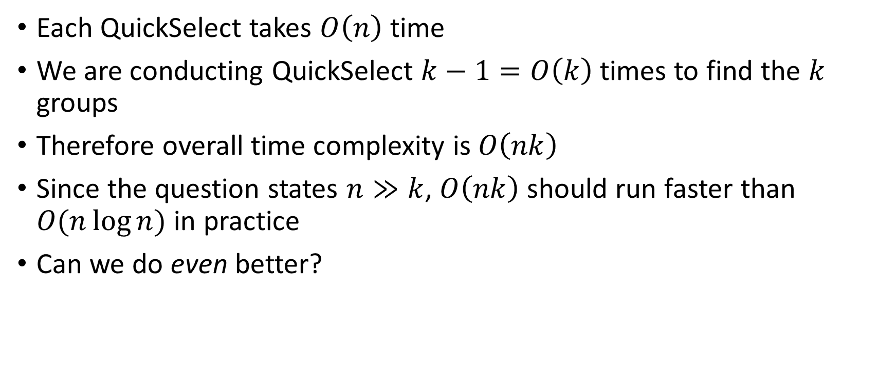
Better Solution – Analysis
Each QuickSelect takes $O\left(n\right)$ time
We are conducting QuickSelect $k−1=O\left(k\right)$ times to find the $k$ groups
Therefore overall time complexity is $O\left(nk\right)$
Since the question states $n≫k$, $O\left(nk\right)$ should run faster than $O(n\log{n})$ in practice
Can we do even better?

Slide 14

Even Better Solution
When we conduct QuickSelect multiple times, we are partitioning the same array multiple times
Instead of recursing on one side to find the target $\overline{w}$, we can recurse on both sides to find all the target $2\overline{w},3\overline{w},…, \left(k−1\right)\overline{w}$ at once

Slide 15
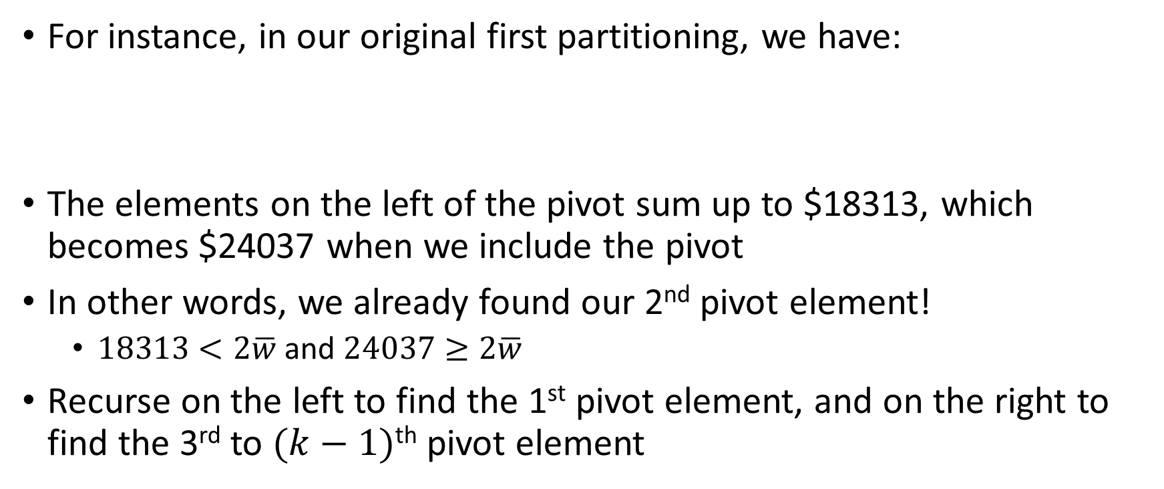
Even Better Solution
Given: $n=100, k=10, ∑w=100000$
Then each group should have wealth of about $\overline{w}=10000$
For instance, in our original first partitioning, we have:
The elements on the left of the pivot sum up to $18313, which becomes $24037 when we include the pivot
In other words, we already found our 2nd pivot element!
$18313<2\overline{w}$ and $24037≥2\overline{w}$
Recurse on the left to find the 1st pivot element, and on the right to find the 3rd to $(k−1)$^{th} pivot element
Age: 17 W: 6500 | Age: 17 W: 950 | Age: 18 W: 3492 | Age: 16 W: 200 | Age: 18 W: 1226 | Age: 17 W: 5700 | Age: 19 W: 245 | Age: 19 W: 5724 | Age: 76 W: 3155 | … | Age: 67 W: 709

Slide 16
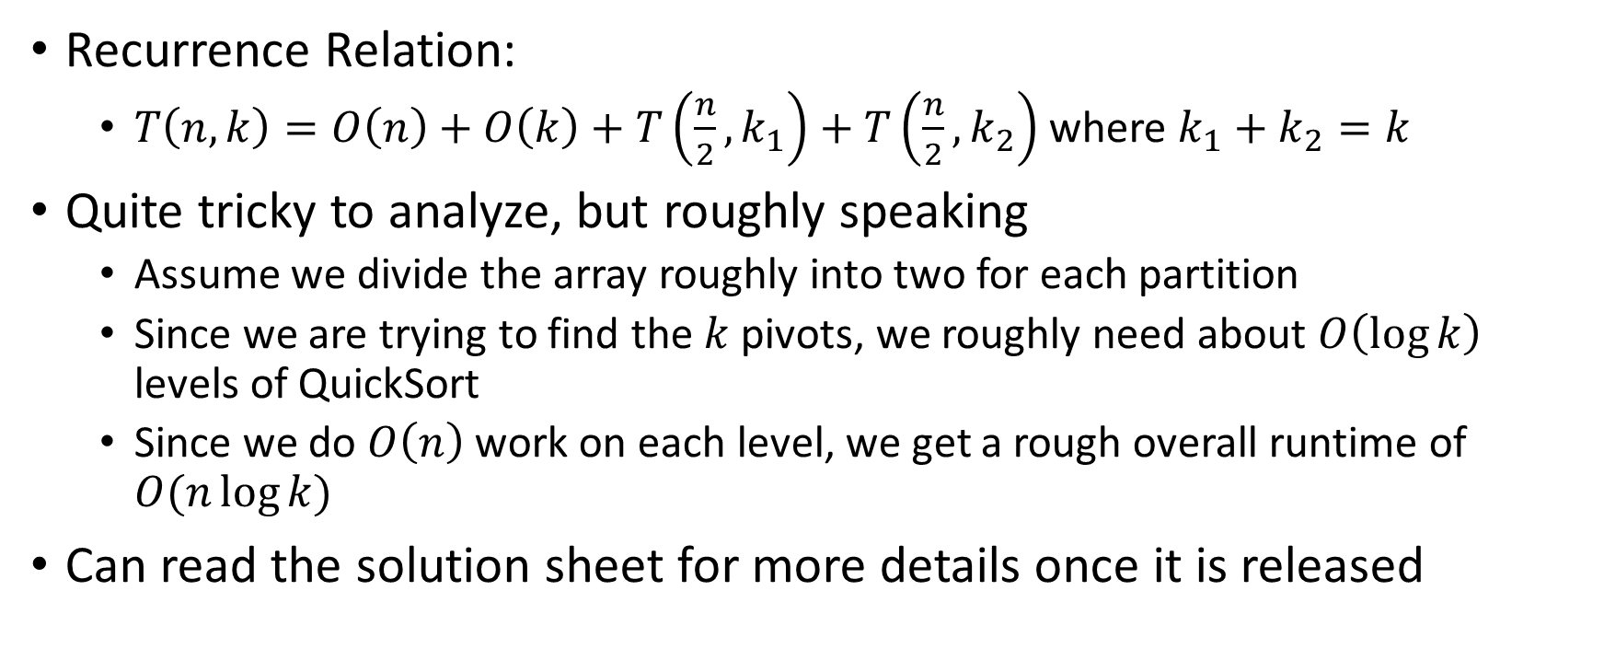
Even Better Solution – Analysis
Recurrence Relation:
$T\left(n,k\right)=O\left(n\right)+O\left(k\right)+T\left(\frac{n}{2},k_{1}\right)+T\left(\frac{n}{2},k_{2}\right)$ where $k_{1}+k_{2}=k$
Quite tricky to analyze, but roughly speaking
Assume we divide the array roughly into two for each partition
Since we are trying to find the $k$ pivots, we roughly need about $O\left(\log{k}\right)$ levels of QuickSort
Since we do $O\left(n\right)$ work on each level, we get a rough overall runtime of $O(n\log{k})$
Can read the solution sheet for more details once it is released

Slide 17

Even Better Solution – Note
As $k→n$, our solution becomes $O(n\log{n})$, which makes sense since as $k→n$, our solution basically becomes QuickSort.

Slide 18
CS2040S Tut 4 Qn 5

Slide 19
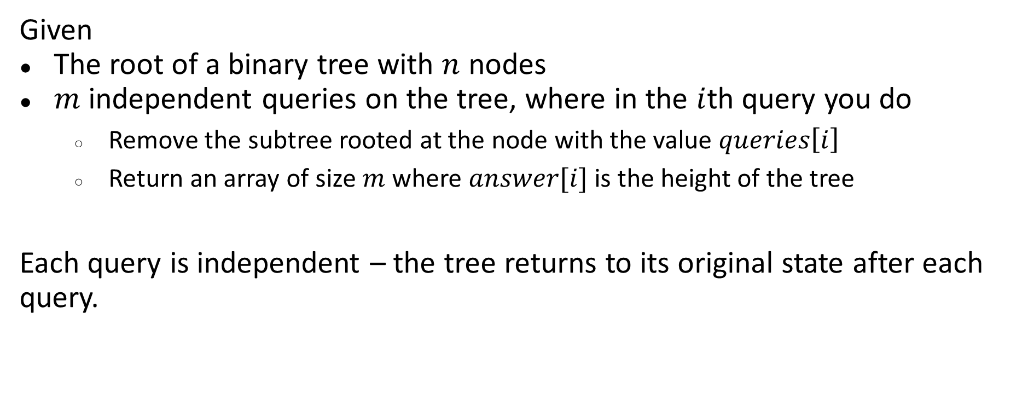
Problem 5: Height of BT After Subtree Removal Query
Given
The root of a binary tree with $n$ nodes
$m$ independent queries on the tree, where in the $i$th query you do
Remove the subtree rooted at the node with the value $queries\left[i\right]$
Return an array of size $m$ where $answer[i]$ is the height of the tree
Each query is independent – the tree returns to its original state after each query.

Slide 20
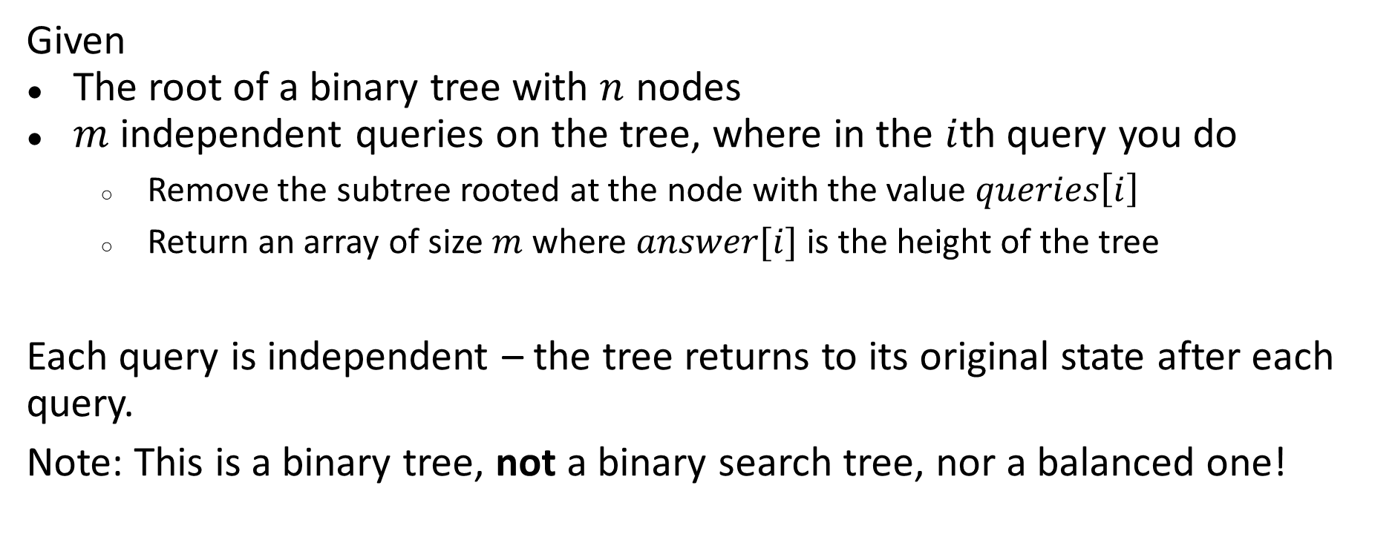
Problem 5: Height of BT After Subtree Removal Query
Given
The root of a binary tree with $n$ nodes
$m$ independent queries on the tree, where in the $i$th query you do
Remove the subtree rooted at the node with the value $queries\left[i\right]$
Return an array of size $m$ where $answer[i]$ is the height of the tree
Each query is independent – the tree returns to its original state after each query.
Note: This is a binary tree, not a binary search tree, nor a balanced one!

Slide 21

Problem 5: Height of BT After Subtree Removal Query
Naïve solution:
For each query value $q$, start recursively calculating the height of the tree starting from the root of the tree
If the node’s value == $q$, immediately return $−1$.

Slide 22
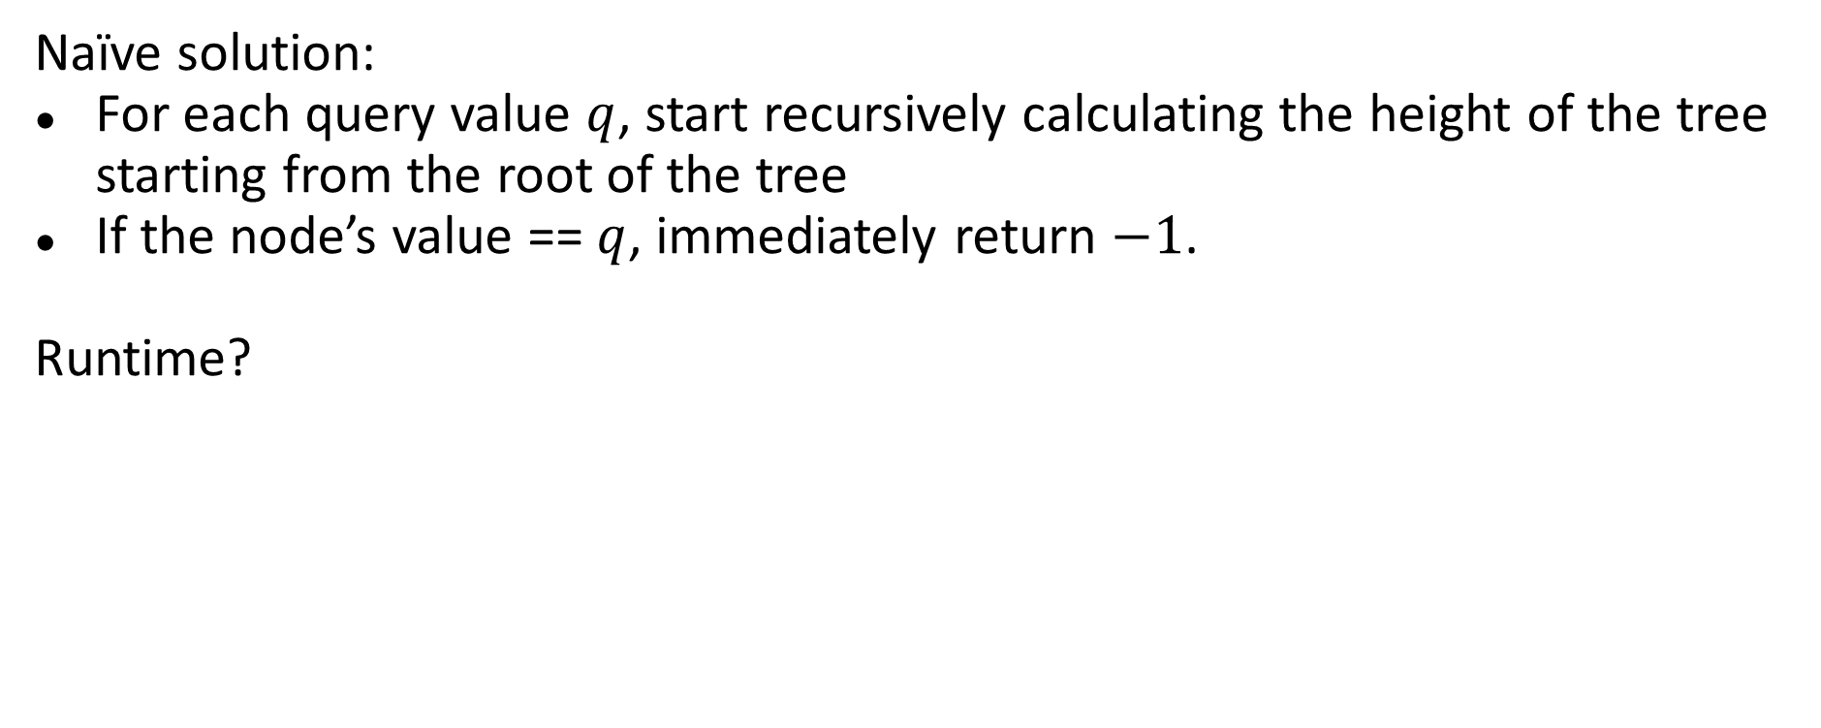
Problem 5: Height of BT After Subtree Removal Query
Naïve solution:
For each query value $q$, start recursively calculating the height of the tree starting from the root of the tree
If the node’s value == $q$, immediately return $−1$.
Runtime?

Slide 23
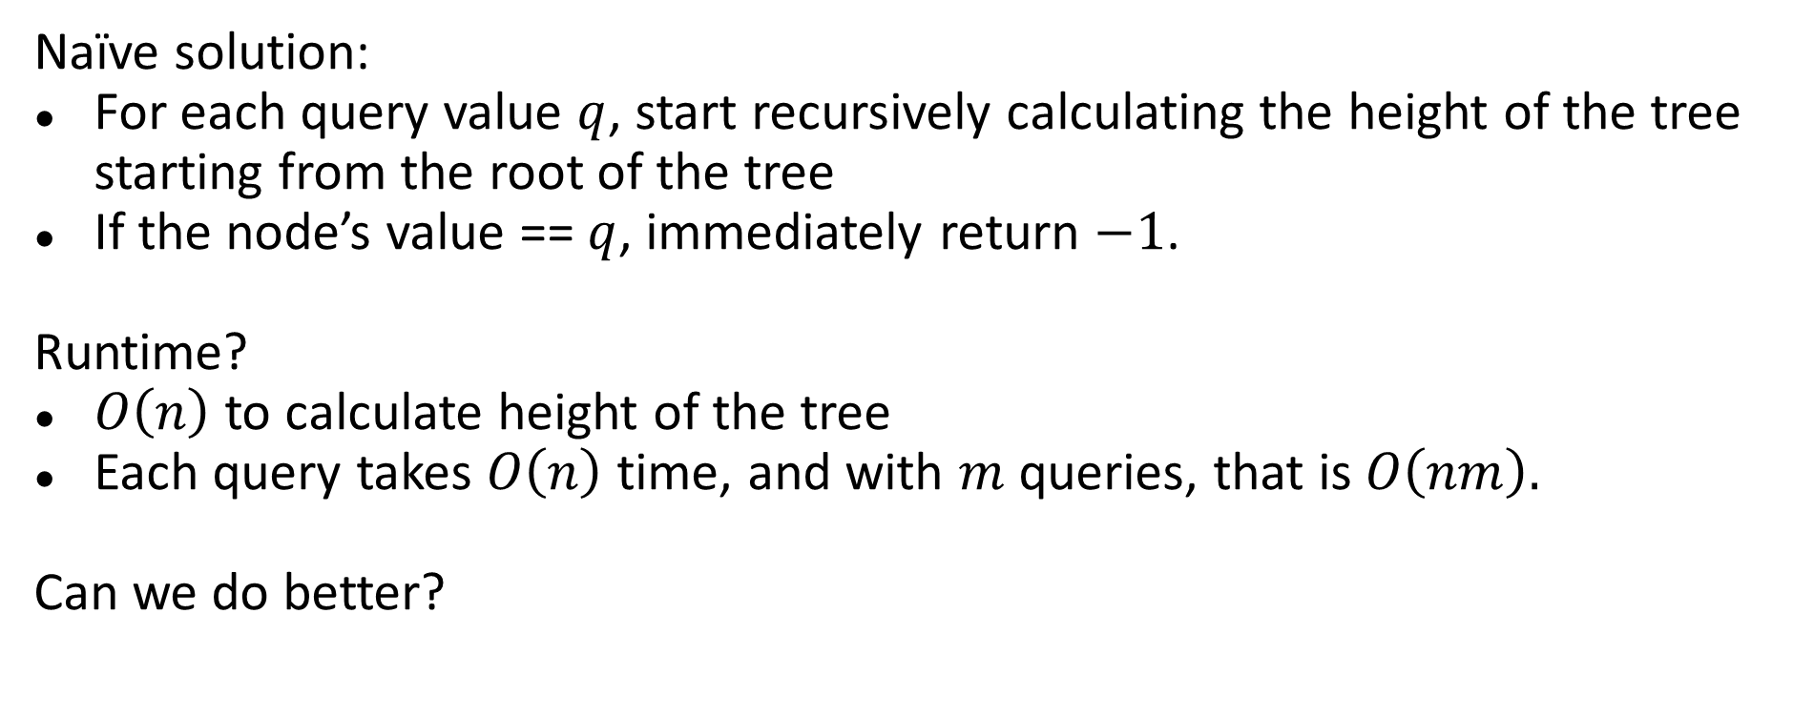
Problem 5: Height of BT After Subtree Removal Query
Naïve solution:
For each query value $q$, start recursively calculating the height of the tree starting from the root of the tree
If the node’s value == $q$, immediately return $−1$.
Runtime?
$O\left(n\right)$ to calculate height of the tree
Each query takes $O\left(n\right)$ time, and with $m$ queries, that is $O\left(nm\right).$
Can we do better?

Slide 24
Problem 5: Height of BT After Subtree Removal Query
Can we do better?
Yes! We can precompute the solution for every node – this will allow our queries to be much faster!

Slide 25
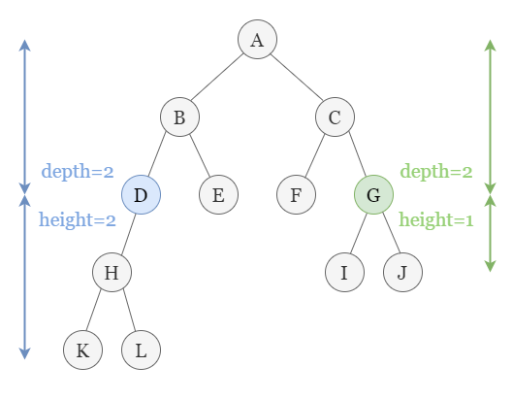
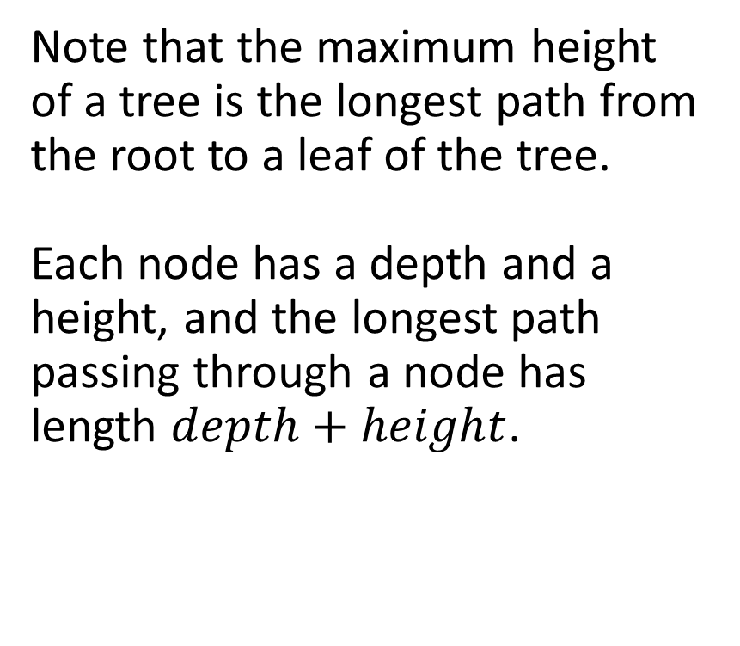
Problem 5: Height of BT After Subtree Removal Query
Note that the maximum height of a tree is the longest path from the root to a leaf of the tree.
Each node has a depth and a height, and the longest path passing through a node has length $depth+height$.

Slide 26
Problem 5: Height of BT After Subtree Removal Query
When a node (say D) is removed, all of its children are removed as well. So every path that goes through D will also stop there.
If the path through D is not the longest, then removing D does not change the height of the tree.
If the path through D is the longest, then we need to find the second longest path.

Slide 27
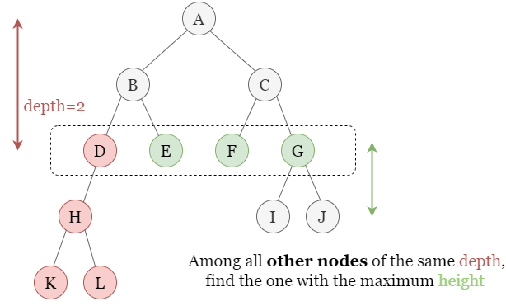
Problem 5: Height of BT After Subtree Removal Query
Hence, for each node, find its “cousin” with the longest path.
In other words, for each level/depth, find the node with the largest and second largest height.

Slide 28
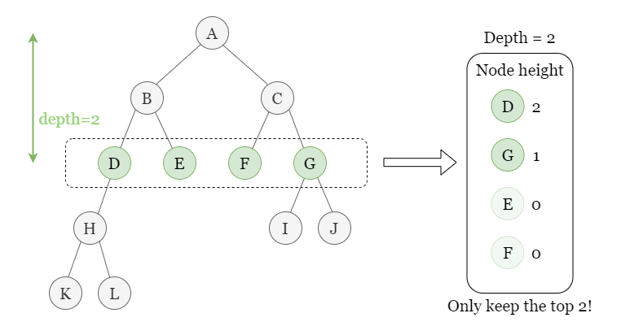
Problem 5: Height of BT After Subtree Removal Query
In this case, the largest height is D, and the second largest height is G.
For D, store G’s height.
For E, F and G, store D’s height.
When we remove a node X, the resultant height of the tree is the depth of the node + the stored height.

Slide 29
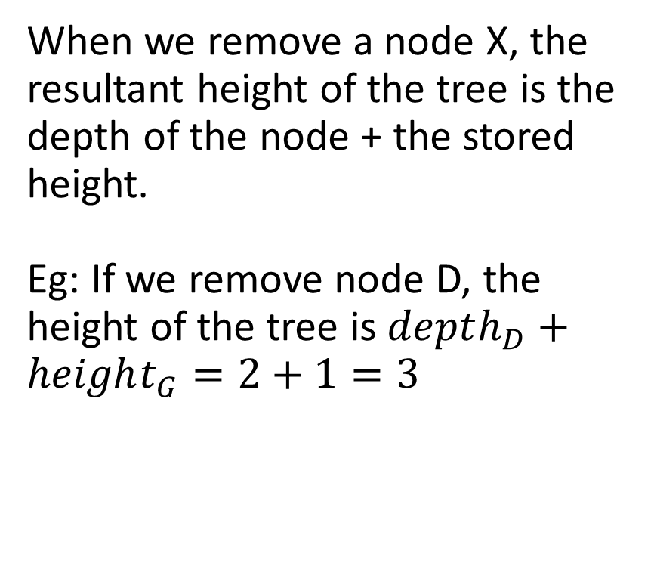
Problem 5: Height of BT After Subtree Removal Query
When we remove a node X, the resultant height of the tree is the depth of the node + the stored height.
Eg: If we remove node D, the height of the tree is $depth_{D}+height_{G}=2+1=3$

Slide 30
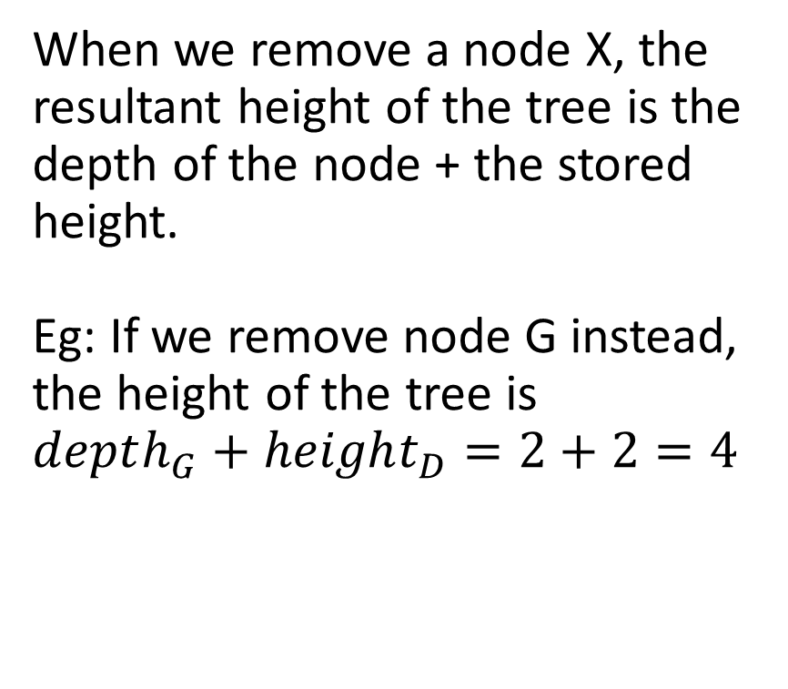
Problem 5: Height of BT After Subtree Removal Query
When we remove a node X, the resultant height of the tree is the depth of the node + the stored height.
Eg: If we remove node G instead, the height of the tree is $depth_{G}+height_{D}=2+2=4$

Slide 31
Problem 5: Height of BT After Subtree Removal Query
(Edge case)
If the level only has one node, then the longest remaining path is just depth – 1.

Slide 32
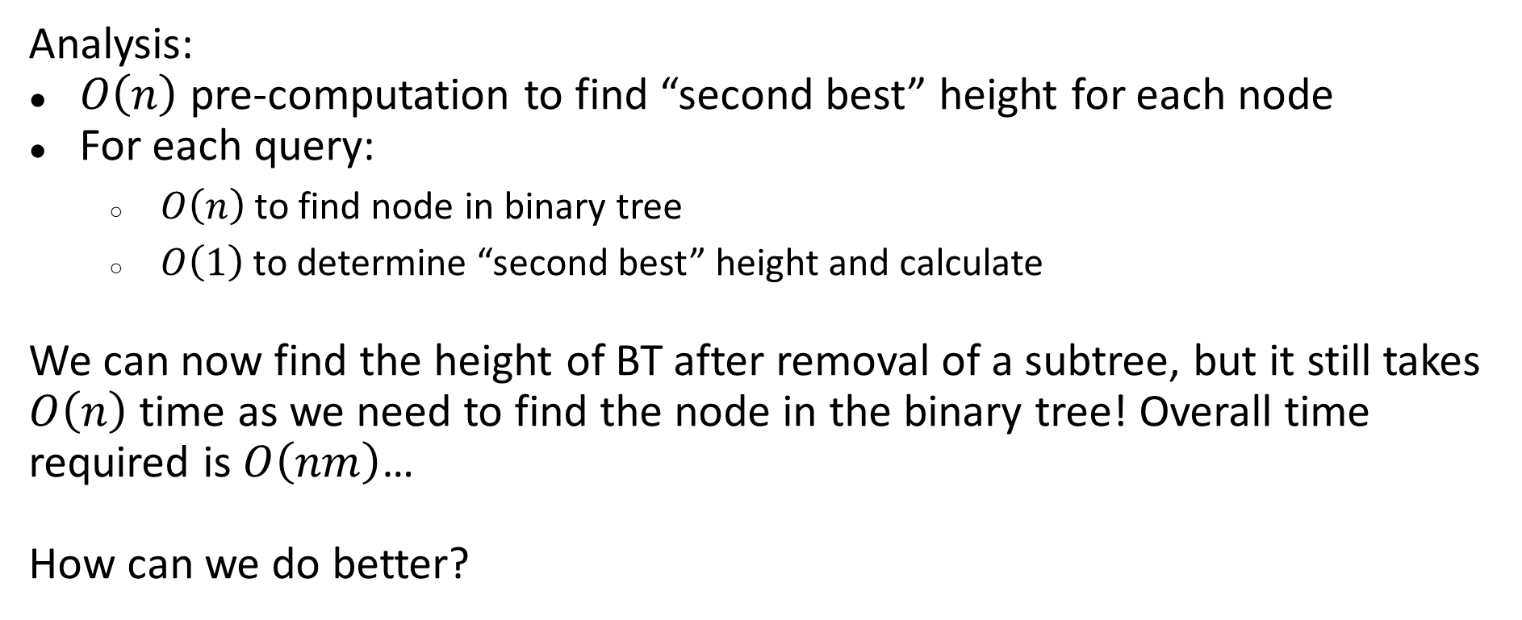
Problem 5: Height of BT After Subtree Removal Query
Analysis:
$O\left(n\right)$ pre-computation to find “second best” height for each node
For each query:
$O\left(n\right)$ to find node in binary tree
$O\left(1\right)$ to determine “second best” height and calculate
We can now find the height of BT after removal of a subtree, but it still takes $O\left(n\right)$ time as we need to find the node in the binary tree! Overall time required is $O\left(nm\right)$…
How can we do better?

Slide 33
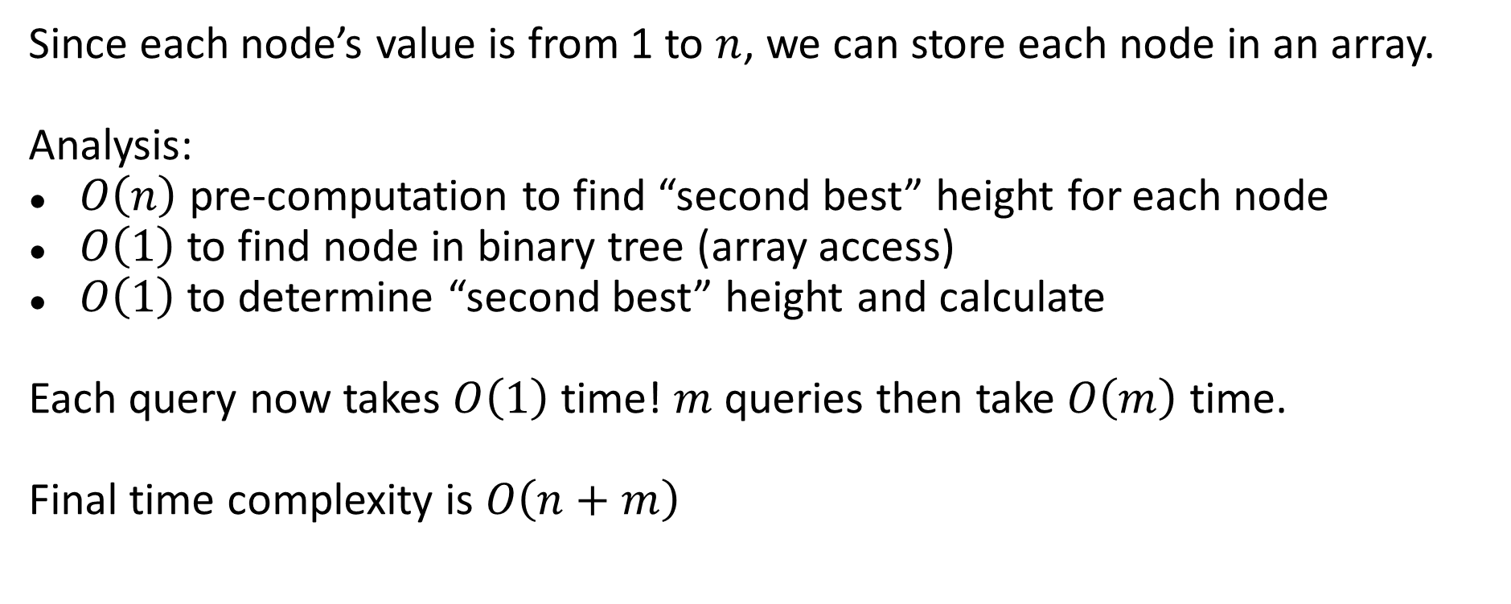
Problem 5: Height of BT After Subtree Removal Query
Since each node’s value is from 1 to $n$, we can store each node in an array.
Analysis:
$O\left(n\right)$ pre-computation to find “second best” height for each node
$O\left(1\right)$ to find node in binary tree (array access)
$O\left(1\right)$ to determine “second best” height and calculate
Each query now takes $O\left(1\right)$ time! $m$ queries then take $O\left(m\right)$ time.
Final time complexity is $O\left(n+m\right)$

Slide 34
Problem 5: Height of BT After Subtree Removal Query
Try implementing the solution!
https://leetcode.com/problems/height-of-binary-tree-after-subtree-removal-queries/

